Slide 1
CH 4. 모폴로지
(Morphological Image Processing Techniques)

Slide 2
Contents
 Overview of Mathematical Morphology
 Basic Morphological Operations
  - Fundamental Definitions
  - Erosion and Dilation
  - Opening and Closing
 Morphological Image Processing Techniques
  - Hit-and-Miss Transform
  - Thinning, pruning and Thickening
  - Morphological Gradient and Laplacian
  - Morphological Pyramid
 Conclusions

Slide 3
Overview
 Morphology
  a branch of biology that deals with the form and structure of animals and plants.
 Mathematical morphology in image processing
  a tool for extracting image components that are useful in the representation and description of region shape.
  can deal with geometrical information such as boundaries, skeletons, and convex hull, etc.
  set operations that transform an input signal in a Euclidian space (binary images are viewed as sets in a 2-D integer space Z2, and grayscale images are sets in Z3).
  uses structuring elements to interact with the set.

Slide 4





Fundamental Definitions
 Function
  A grayscale input signal, denoted by f.
  f(n): the nth sample of 1-D signal f.
  f(m,n): the (m,n)th sample of 2-D signal f.
 Set
  A particular domain in the Euclidian space
  A 1-D set B = {0, 1, 2)
  The reflection set of B, = {0, -1, -2}
  A 2-D set B = {(0,0), (0,1), (1,0)},
  = {(0,0), (-1,0), (0,-1)}
B
Origin
B

Slide 5
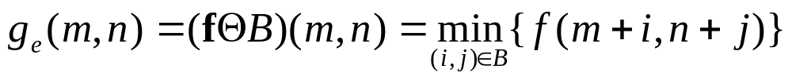


FSP Erosion and Dilation I
 FSP(function and set processing) erosion
 FSP dilation
 e.g. B = {0, 1, 2}
 e.g. B = {(0,0), (0,1), (1,0)}

Slide 6
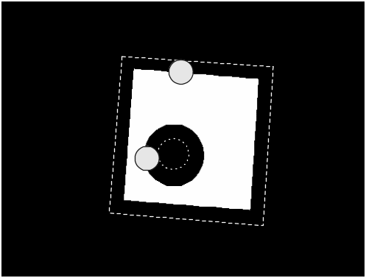

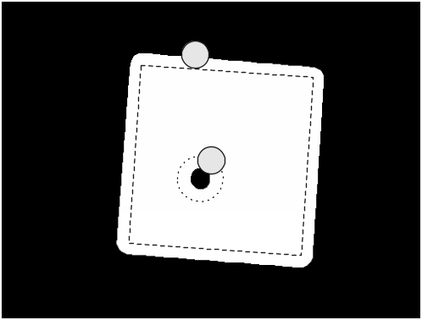
FSP Erosion and Dilation II
Eroded image
using
disc-shaped SE
Original image
Dilated image
using
disc-shaped SE

Slide 7
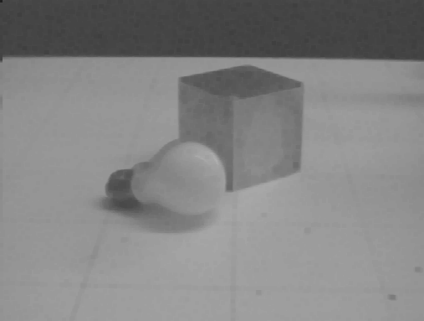
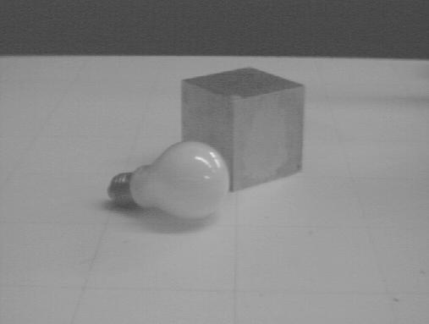
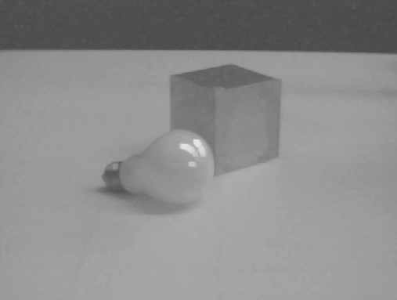
Example of FSP Erosion and Dilation
Eroded image
using 3x3
flat square SE
Original image
Dilated image
using 3x3
flat square SE

Slide 8
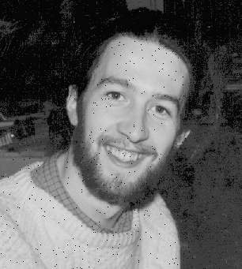



Impulsive-noise Reduction using Erosion and Dilation
Input image
corrupted by
pepper noise
Dilated image
using 3x3
flat square SE
Input image
corrupted by
salt noise
Eroded image
using 3x3
flat square SE

Slide 9
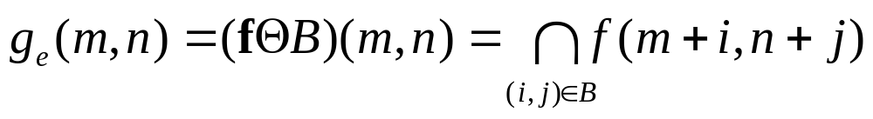
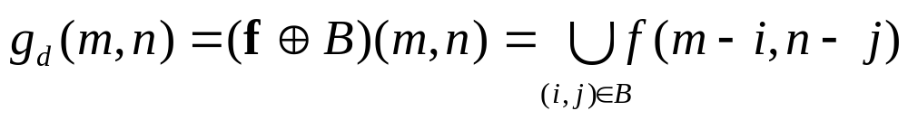
SP Erosion and Dilation
 A binary input signal can be treated as a set in the Euclidian space.
 SP(set processing) erosion
 SP dilation
 e.g. B = {(0,0), (0,1), (1,0)}

Slide 10
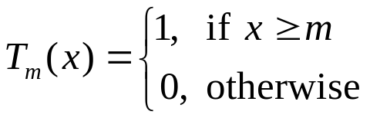
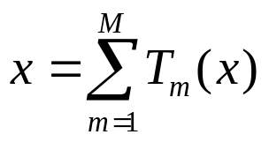
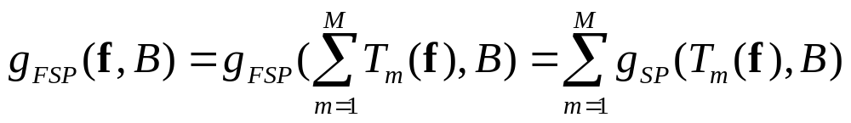
FSP and SP systems I
 Threshold decomposition
  (M: grayscale resolution )
 FSP and SP systems

Slide 11
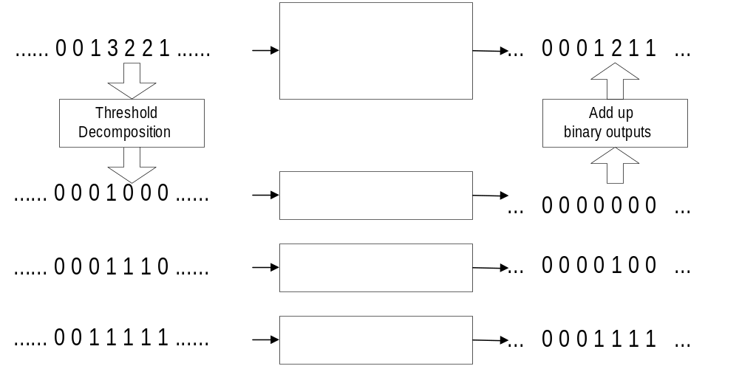
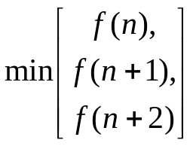



FSP and FP systems II

Slide 12
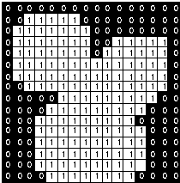

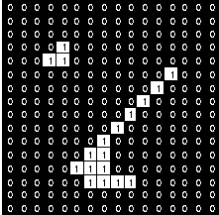


Example of SP Dilation and Erosion
Original image
Dilated
image
Eroded
image

Slide 13
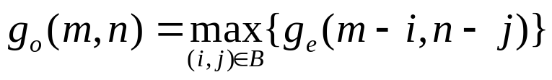
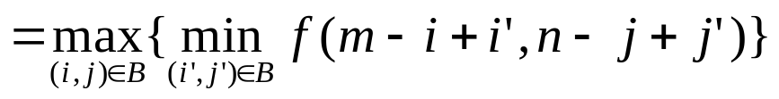
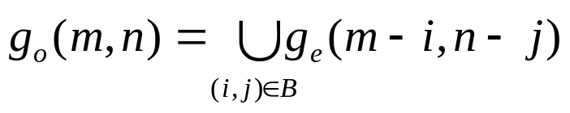
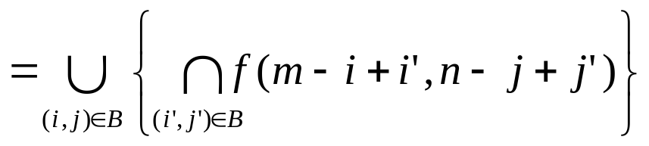
Opening
 Erosion followed by dilation.
 FSP opening
 SP opening

Slide 14



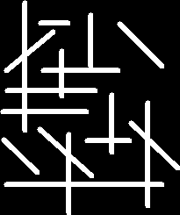

Effects of Opening
eliminates the bright objects smaller than the SE.
Opening using
disc-shaped SE
Opening using
horizontally oriented SE
Opening using
vertically oriented SE

Slide 15
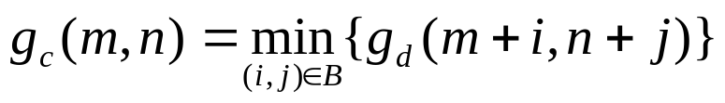
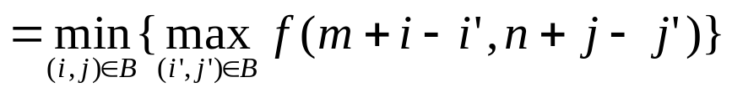
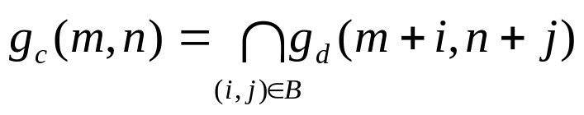
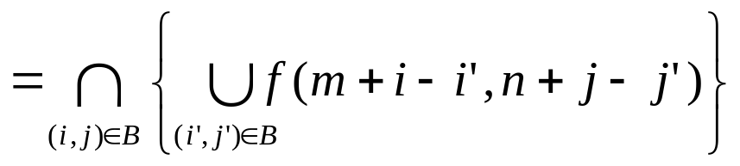
Closing
 Dilation followed by erosion.
 FSP opening
 SP opening

Slide 16


Effects of Closing
eliminates dark objects smaller than the SE.
Original image
Closed image with
22-pixel diameter disc

Slide 17
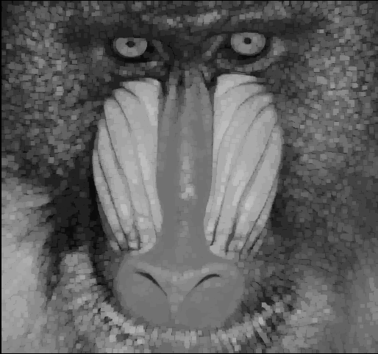
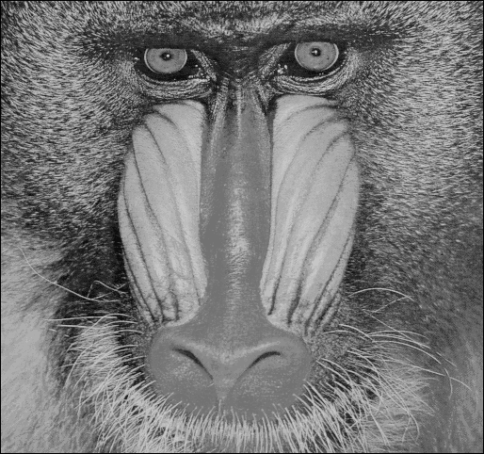
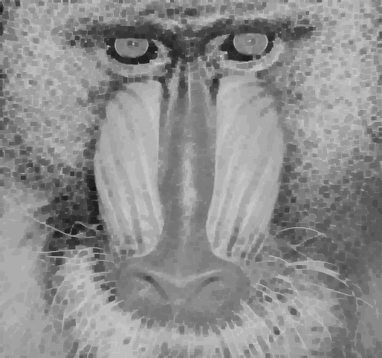
Example of FSP Opening and Closing
Opened image
with 5x5 flat
square SE
Closed image
with 5x5 flat
square SE
Original image

Slide 18


Impulsive-noise Reduction using Opening and Closing
Input image
corrupted by
pepper noise
Closed image
using 3x3
flat square SE
Input image
corrupted by
salt noise
Opened image
using 3x3
flat square SE

Slide 19


Function Processing Systems
 Erosion of a function f by a function k
  K: domain of k
 Dilation
 Opening
 Closing

Slide 20
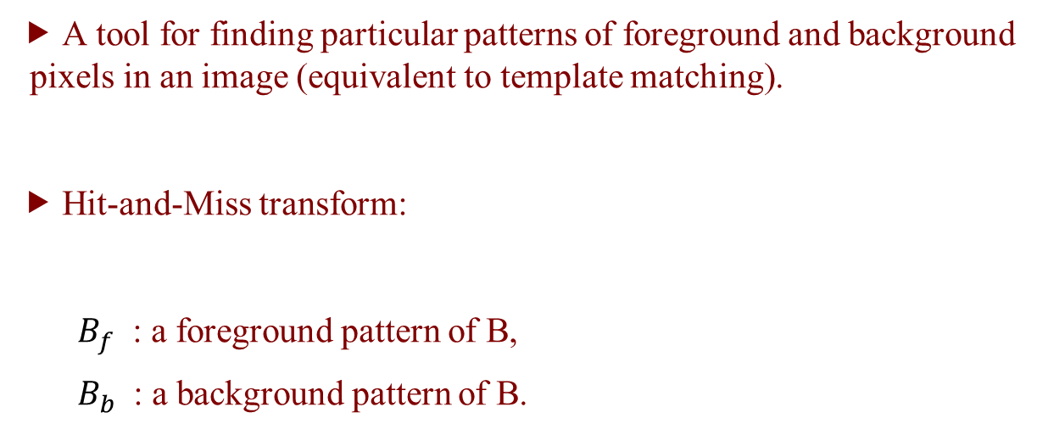
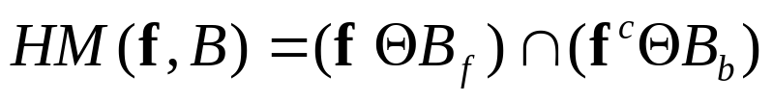
Hit-and-Miss Transform

Slide 21
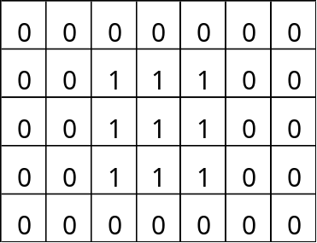
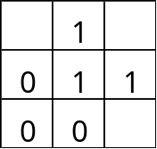


Example of Hit-and-Miss Transform I
Find pattern B from the given input image A.
  1. Generate Bf and Bb.
1: foreground
0: background
blank: don’t care
B
f
B_{f}
B_{b}

Slide 22
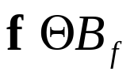
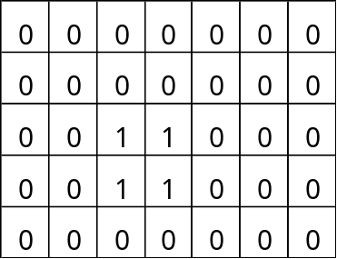

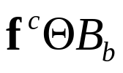
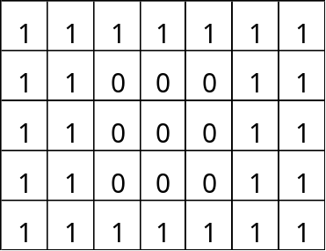
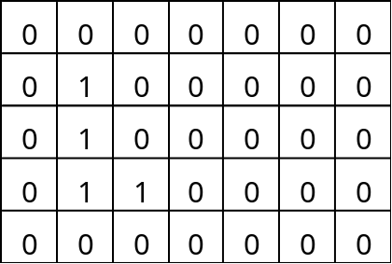
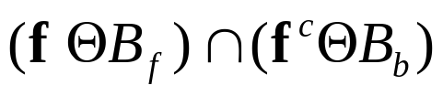
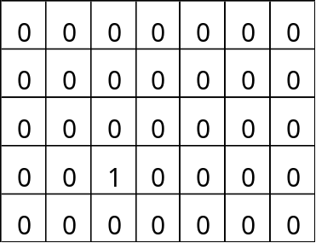
Example of Hit-and-Miss Transform II
  2.
  3. and
  4.

Slide 23
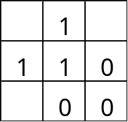
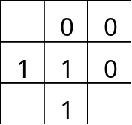
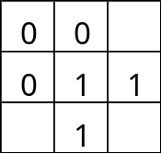
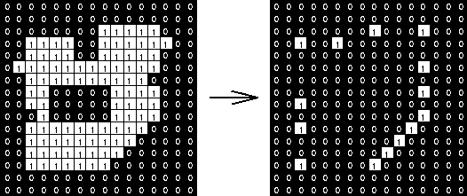
SE for Hit-and-Miss Transform I
Convex corner detector

Slide 24
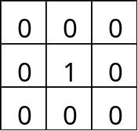
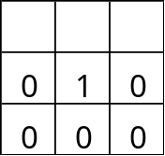
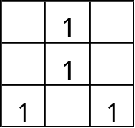
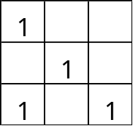



SE for Hit-and-Miss Transform II
Isolated pixels, End-points, Triple-junction points
Input image
Triple-junction
detection
End-points
detection

Slide 25

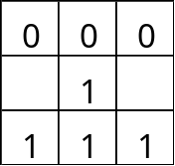
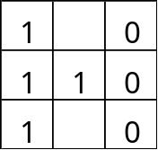
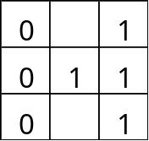

Thinning
 Thinning
  - The iterative procedure to delete edge points of a region
  while the topological information of the region is preserved,
  such as end-points, connectivity, etc.
 Morphological thinning
  -
  - Following SE’s are iteratively applied for thinning.

Slide 26

Example of Thinning
Original image
Morphological thinning

Slide 27


Pruning
 A tool for removing undesirable short spurs of the object
or its boundary.
 A thinning procedure using following patterns
and their 90º-rotations (total 8 patterns).
 Pruning until convergence will actually remove all pixels
except those that form closed loops.

Slide 28


Example of Pruning
Input image
Pruning results after
convergence

Slide 29



Thickening

  -Thickening is the dual of thinning, i.e.,
  thinning the foreground is equivalent to thickening the background.
  - Following patterns and their 90º rotations are iteratively applied.
 Convex hull
  - Connection of the convex contours of the boundary
  - Thickening using following patterns and their 90º rotations.

Slide 30


Example of Thickening
Input image
Thickening result using
convex hull algorithm.

Slide 31





Morphological Smoother
Open-closing:
Close-opening:
Input image
OC filtered image
with 5x5 flat SE
CO filtered image
with 5x5 flat SE

Slide 32


Morphological Gradient
Morphological gradient:
Input image
Morphological gradient
using 5x5 flat SE

Slide 33


Morphological Laplacian
Morphological Laplacian:
Input image
Morphological Laplacian
using 5x5 flat SE
(128-graylevel biased for display)

Slide 34


Morphological Top-hat Transform
Morphological top-hat transform:
Input image
Morphological Top-hat
using 5x5 flat SE

Slide 35

Morphological Pyramid
 Morphological low pass filter
  - Open-closing or close opening filter
 Morphological reconstruction filter
  - Dilation or closing filter

Slide 36






Example of Morphological Pyramid

Morphological
low pass pyramid
Morphological
band pass pyramid
Level 1
(128x128)
Level 2
(64x64)
Level 3
(32x32)

Slide 37
Conclusions
 Basic morphological operations
  - Fundamental definitions on function and set operations.
  - FSP, SP and FP morphological operations
    Erosion, dilation, opening and closing
 Morphological Image Processing Techniques
  - Hit-and-Miss transform
  - Morphological thinning, pruning, thickening
  - Morphological gradient and Laplacian, top-hat
  - Morphological Pyramid

